Slide 1
Student Forum
22/02/2023
Notes:
Hello and welcome to all Class Reps. We are delighted to have you all here.
We will take your feedback to UL staff and advocate on your behalf.
Also delighted to have our Student Council department reps with us. The department reps can assist class reps within their department with various issues and they also gather departmental feedback.
Welcome to Student Officers and Gillian
Quick Poll:
Has everyone here been formerly elected as a Class rep? (received email from John)

Slide 2
What to Expect!
Welcome & Housekeeping
Updates
Breakout Rooms
Prize!
The Year So Far.....
Next Steps

Slide 3
Housekeeping
Please keep your mic off unless you want to speak
This meeting will be recorded
If you asked a question in the chat box and it doesn’t get answered, please private message Siobhan

Slide 4
Updates: Student Centre Officer Updates After breakout rooms: Financial Strategic Plan Elections
Up

Slide 5
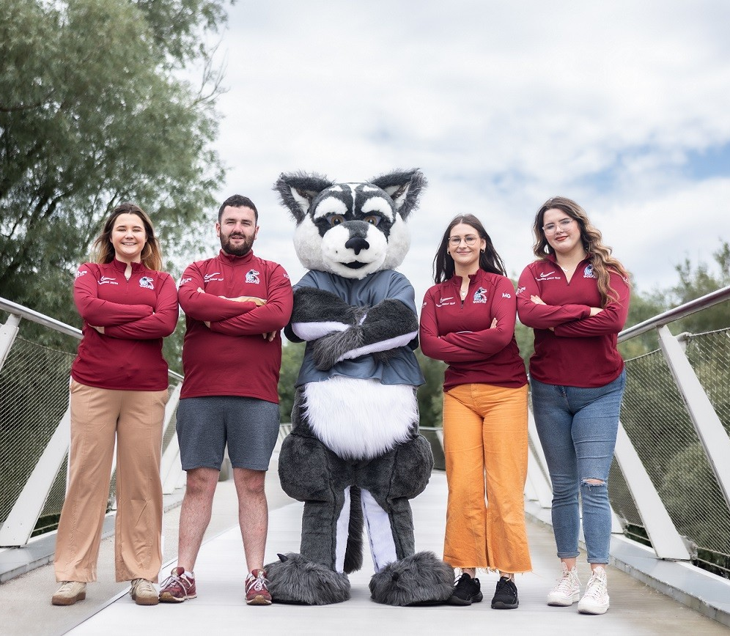
The Year So far!
Maeve R
Maeve G
Kieran
Laura

Slide 6
Maeve R
PCC Rent Pressure Zones
Stables Prices on alcohol
Stables contract renewed for 7 years
Student Centre back on track!
Microwaves on North
Commuter Hub continuation: sponsorship from Flavahans and Credit Union
Continuing to advocate for more parking
Turkey and Syrian Earthquake Relief
Student Side Hustles

Slide 7
Maeve G
Participated in the Wonkhe Study Tour with Siobhán to research European Student Unions and investigate ways in which we could improve our student voice.
Recruited a Welfare Team
Hosted "Speed Friending" event on 14th February
Working with the University on a Sexual Misconduct, Sexual harassment and violence policy.
Conducted Wellbeing Focus groups to feed into ULSL Mental Health and Wellbeing Strategy
Working on promoting sexual health on campus on promoting regular STI checks and information on campus.
Togetherall
Collaborating with Laura on a student safety piece for the SOS beacons

Slide 8
Kieran
Assisting with the student rep outreach strategy. Trying to increase student engagement as much as possible
Hosted the first Class Rep Forum on Wednesday the 8th of February. This was a great platform to get some valuable feedback from our student reps
Regularly meeting with Patrick Ryan and the working group to work on the Student Survey;
Sat on the UL excellence in teaching awards – EHS panel which was a great experience.
Currently working in collaboration with the learning centres to promote their services

Slide 9
Laura
Ukranian Students: advocating for funding to sustain Ukranian students wellbeing while here in the university of limerick
Sanctuary Students: Creating community and building relationships between our sanctuary students via coffee mornings
Power Panel: female empowerment event to encourage women to have their voice heard
Student parents: holding a student parent Santa to bring together students and their families to celebrate Christmas
Tours: facilitating tours with incoming access students, CLETB and city campus students
Rainbow pathways: Working with LGBTQIA+ support organizations to help better inform wellbeing support for the community

Slide 10
Breakout Rooms
Participants will be spilt into 2 groups
2 Officers assigned to each group
10 mins to discuss 2 topics – then comeback to larger group for feedback (5 Mins) & repeat.
Feedback & Qs recorded via Padlet
Notes:
Please note any important information that you would like to take back to your class.

Slide 11
Topic 1. Student Experience - Food on Campus and Student Spaces, Student Engagement, Sustainability Topic 2. Equality & Diversity – Inclusivity? Feeling Unheard?

Slide 12
Feedback?

Slide 13
Topic 3. Welfare – Harm Reduction Week, STI Testing? Topic 4. Academic - Online resources? Timetables? Representation? Exam lead up?

Slide 14
Feedback?

Slide 15
Updates: After breakout rooms: Financial Strategic Plan Elections
Up

Slide 16
PRIZE: 3 X 100 EURO GROCERY VOUCHERS

Slide 17
Prizes!
Thank you for attending!
Notes:
4 x €25 Just Eat vouchers
Pick a number and count students on screen

